Slide 1


Digital Egypt Pioneers Initiative - DEPI
HUMAN RESOURCES DATASET ANALYSIS
Behind the Numbers: What HR Data Tells Us About People and Performance

Slide 2

Project Overview
1
Gain insights into:
Employee performance
Employee satisfaction
Attrition rates
Identify key factors influencing employee turnover
Determine which departments and job roles are more affected by turnover
Asses the impact of : education,financial benefits, managerial level on salaries and promotions
Investigate the relationship between work-life balance ,travel frequency, employee retention
Performance gaps assessment

Slide 3


Tools used
2
Python
Microsoft Excel
Data Loading – Imported multiple HR-related datasets.
Data Cleaning – Checked for missing values and inconsistencies.
Data Merging – Combined datasets for unified analysis.
Exploratory Analysis – Visualized trends and key metrics.
Insight Generation – Identified patterns in performance and satisfaction.
Microsoft Excel was employed for preliminary data examination, including filtering and pivot table generation.
Employed Excel’s filtering and sorting tools to isolate specific employee groups and performance metrics for targeted review
Tableau
Google Meet
Tableau was subsequently used to develop interactive dashboards and data visualizations, facilitating clear and effective communication of key insights to stakeholders.
Built interactive dashboards to visualize trends in employee satisfaction, performance ratings, and demographic distributions.
We used Google Meet to discuss the work details and planning. During the meeting, we agreed on the required tasks and assigned roles accordingly.

Slide 4
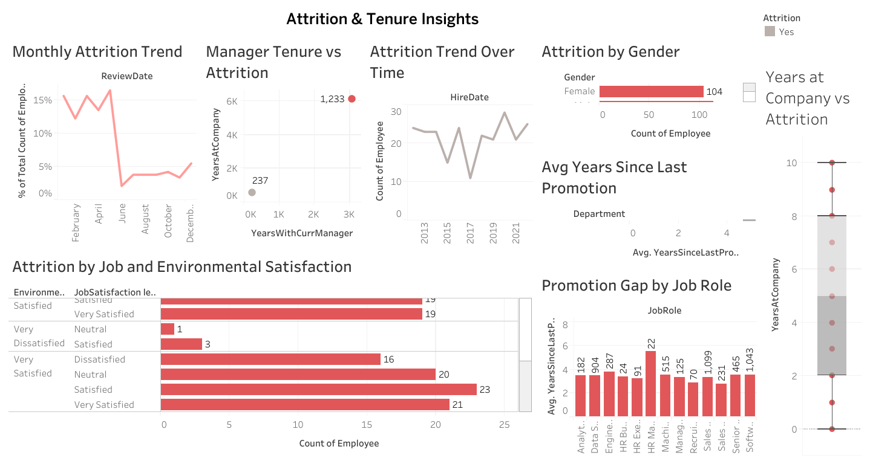
Key visualizations and insights
Attrition& Tenure Insights
2
Attrition peaks early in the year and varies by hire date.
Longer time since last promotion is linked to higher attrition.
Attrition is higher among employees with neutral or low satisfaction.
Promotion gaps vary by job role, potentially affecting retention.
Female employees show higher attrition in the dataset.

Slide 5
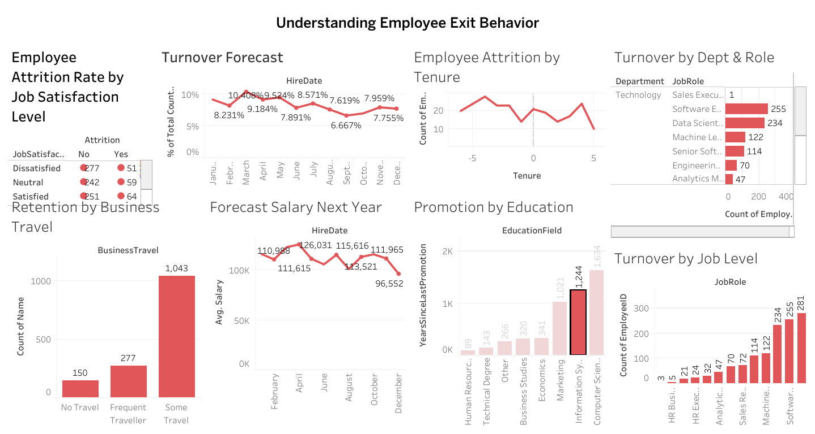
Key visualizations and insights
understanding Employee Exit Behavior
3
Job Satisfaction: Employees with lower satisfaction levels show higher attrition rates.
Seasonal Turnover Forecast: Turnover peaks in February and dips in late summer.
Tenure & Attrition: Most exits occur within the first few years of tenure.
Department & Role: High turnover is concentrated in roles like Software Engineer and Data Scientist, especially in the Technology and Sales departments.

Slide 6
Key visualizations and insights
understanding Employee Exit Behavior
3
Business Travel: Employees who travel occasionally are retained more, while frequent travelers show moderate attrition.
Salary Forecast: Predicted average salaries fluctuate, with a drop in December.
Education & Promotions: Employees in technical or computer science fields tend to have longer gaps since their last promotion.
Turnover by Job Level: Turnover is highest in mid-level technical roles

Slide 7
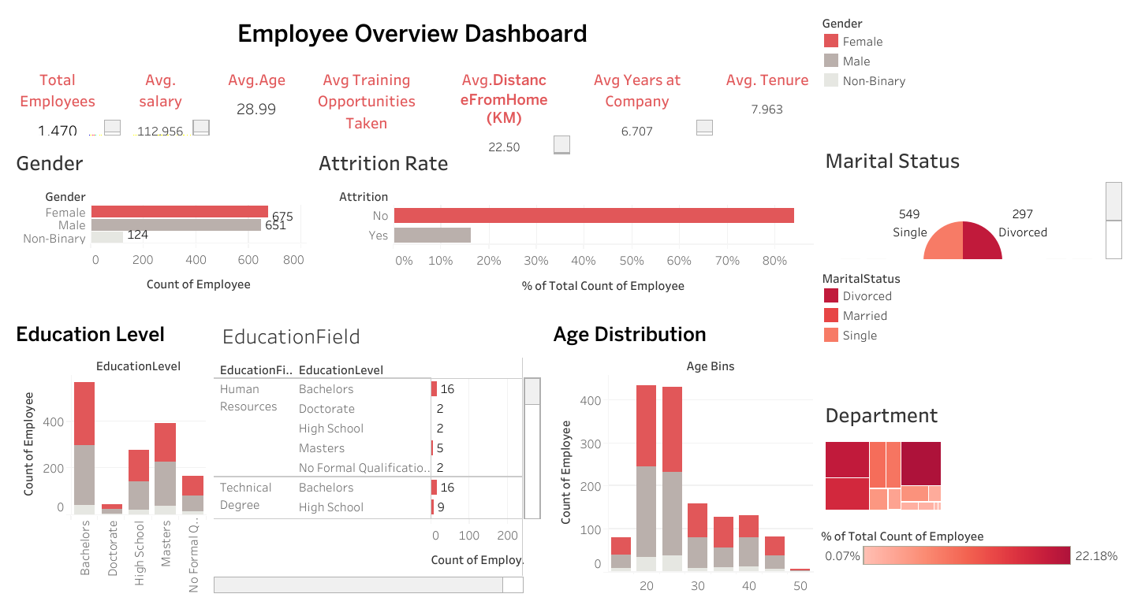
Key visualizations and insights
Employee Overview Dashboard
4
High Employee Turnover: The most striking insight is the extremely high attrition rate (80%). This suggests significant issues with employee retention that need immediate investigation.
Younger Workforce: The average age of around 29 indicates a relatively young workforce. This could have implications for career development, benefits expectations, and overall company culture.
Gender Imbalance: There's a noticeable gender imbalance, with more male employees than female or non-binary employees. This might warrant a review of hiring practices and workplace inclusivity.

Slide 8
Key visualizations and insights
Employee Overview Dashboard
4
Sales Dominance: The Sales department being the largest highlights its importance to the organization's success. Understanding the dynamics and potential attrition within this department is crucial.
Potential Link Between Demographics and Attrition: It would be beneficial to further analyze if there are correlations between demographics (age, gender, marital status, education level, department) and the high attrition rate.
Focus on Bachelor's Degrees: The prevalence of Bachelor's degrees suggests a workforce that values formal education. The concentration in Human Resources among Bachelor's holders could indicate a strong HR function or a history of hiring for those skills.

Slide 9
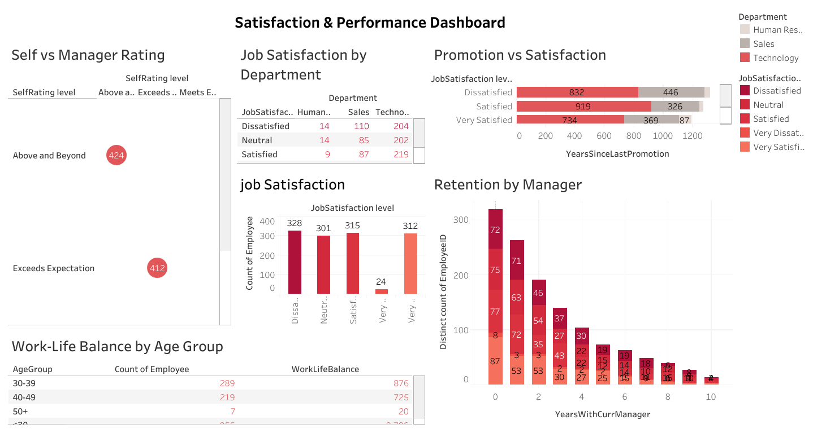
Key visualizations and insights
Satisfaction& performance Dashboard
5
Employees largely rate their performance highly ("Above and Beyond" or "Exceeds Expectation"). Job satisfaction varies by department, with HR showing higher dissatisfaction. Overall satisfaction is skewed positively, but lack of promotion correlates with dissatisfaction. Retention varies significantly by manager. Younger employees report better work-life balance than older groups. Key takeaways include addressing HR dissatisfaction, focusing on career progression, analyzing manager impact on retention, and understanding work-life balance issues in older employees

Slide 10
Key visualizations and insights
Satisfaction& performance Dashboard
5
Employees largely rate their performance highly ("Above and Beyond" or "Exceeds Expectation"). Job satisfaction varies by department, with HR showing higher dissatisfaction. Overall satisfaction is skewed positively, but lack of promotion correlates with dissatisfaction. Retention varies significantly by manager. Younger employees report better work-life balance than older groups. Key takeaways include addressing HR dissatisfaction, focusing on career progression, analyzing manager impact on retention, and understanding work-life balance issues in older employees

Slide 11
Insights and strategic recommendations
6
Section 1: Employee Turnover Analysis
Current Turnover Rate:
The company’s current turnover rate stands at 16.7%, which is moderate. While not alarming, it highlights significant opportunities for improving talent retention—particularly during the early stages of employment.
Key Drivers of Attrition:
Length of Tenure: The majority of resignations occur within the first two years, indicating a critical need for more structured onboarding and engagement during this period.
Managerial Continuity: Employees with stable reporting lines report higher satisfaction and are more likely to stay. Frequent changes in direct managers are linked to disengagement and exits.
Work-Life Balance: Employees citing poor balance between their professional and personal lives are more likely to leave the organization.
Business Travel: Roles requiring frequent travel show a strong correlation with higher turnover, particularly in technical or operational positions.
Departments & Roles Most Affected:
The Research & Development department, particularly roles like Lab Technicians, show the highest attrition rates.
These same areas report low satisfaction levels, as confirmed through Tableau dashboards.

Slide 12
Insights and strategic recommendations
7
Section 2: Employee Satisfaction & Performance Alignment
Key Observations:
Employees who report higher job satisfaction tend to achieve stronger performance ratings, reinforcing the link between engagement and productivity.
Tableau dashboards reveal distinct satisfaction gaps across specific departments, which directly impact overall performance and morale.
Manager-Employee Dynamics:
A long-term, positive relationship with a direct manager is a critical driver of employee satisfaction and retention.
There is a consistent discrepancy between employee self-assessments and manager evaluations, with managers generally adopting a more conservative stance.
Impact of Training & Development:
Employees who received training within the past year:
Reported higher job satisfaction.
Were more likely to be promoted or shifted to more impactful roles.

Slide 13
Insights and strategic recommendations
8
Section 3: Compensation & Equity Analysis
Salary Trends:
The current average salary is approximately $61,443.50 per year.
It is projected to increase to $62,039.60 next year based on regression modeling.
This gradual rise aligns with increased tenure and professional experience.
Departmental and Demographic Differences:
The Finance and HR departments show the highest salary averages.
There is a strong positive correlation between salary and years of experience.
A notable gender pay gap exists, with men earning more on average, highlighting a need for equity-focused salary reviews.
Section 4: Predictive Hiring & Workforce Planning
Forecasted Hiring Needs (via predictive modeling):
Research & Development (R&D): 12 projected hires
Sales Department: 9 projected hires
HR Department: 6 projected hires
Value of Data-Driven Planning:
These projections offer a precise roadmap for HR teams to align hiring strategies with future business needs.
Leveraging predictive insights helps:
Avoid understaffing.
Prevent overhiring.
Enhance agility and team performance.

Slide 14
Insights and strategic recommendations
9
Section 5: Promotion, Tenure & Talent Development
Promotion Indicators:
The most influential factors for promotion include:
Years with the company.
Time spent in the current role.
Length of relationship with the current manager.
Interestingly, education level has shown a weak correlation with promotion or salary growth, indicating that tenure and managerial continuity carry more weight in career progression.
Tenure Insights:
Tableau dashboards reveal a significant drop in employee retention within the first 12 to 24 months of employment.
This early stage represents a strategic window for HR to focus on:
Strong onboarding programs.
Continuous managerial and developmental support.
Cultivating organizational belonging from the start.

Slide 15

HR Action Plan & Implementation Roadmap
10
Link training to promotion
Improve new hire retention
Design structured learning paths tied to promotion eligibility.
Communicate how training supports career advancement.
Launch a comprehensive onboarding and mentorship program covering the first 24 months.
Include regular check-ins and milestone reviews.
Enhance satisfaction in high-risk departments
Improve performance evaluation systems
TDeploy quarterly employee satisfaction surveys.
Conduct standardized exit interviews for data-driven insights.
Implement 360-degree performance feedback.
Provide training to managers on fair and effective evaluations.

Slide 16
HR Action Plan & Implementation Roadmap
11
Ensure compensation fairness
Conduct biannual salary audits.
Monitor and address gender or departmental pay gaps.
Adopt predictive hiring practices
Use forecasting models to inform annual hiring plans.
Align hiring needs with projected departmental growth.
Promote managerial stability
Minimize frequent manager changes for employees.
Monitor the employee-manager relationship as a retention factor.

Slide 17
Digital Egypt Pioneers Initiative - DEPI
THANK
YOU
Team members :
Huda Adel Hassan
Myriam Ehab Milad
Omar Ahmed Abdallah
Philopateer Wael Bekhit

